Slide 1
Book Recommendation App
Python Intermediate - Zeynep B. SAHIN

Slide 2
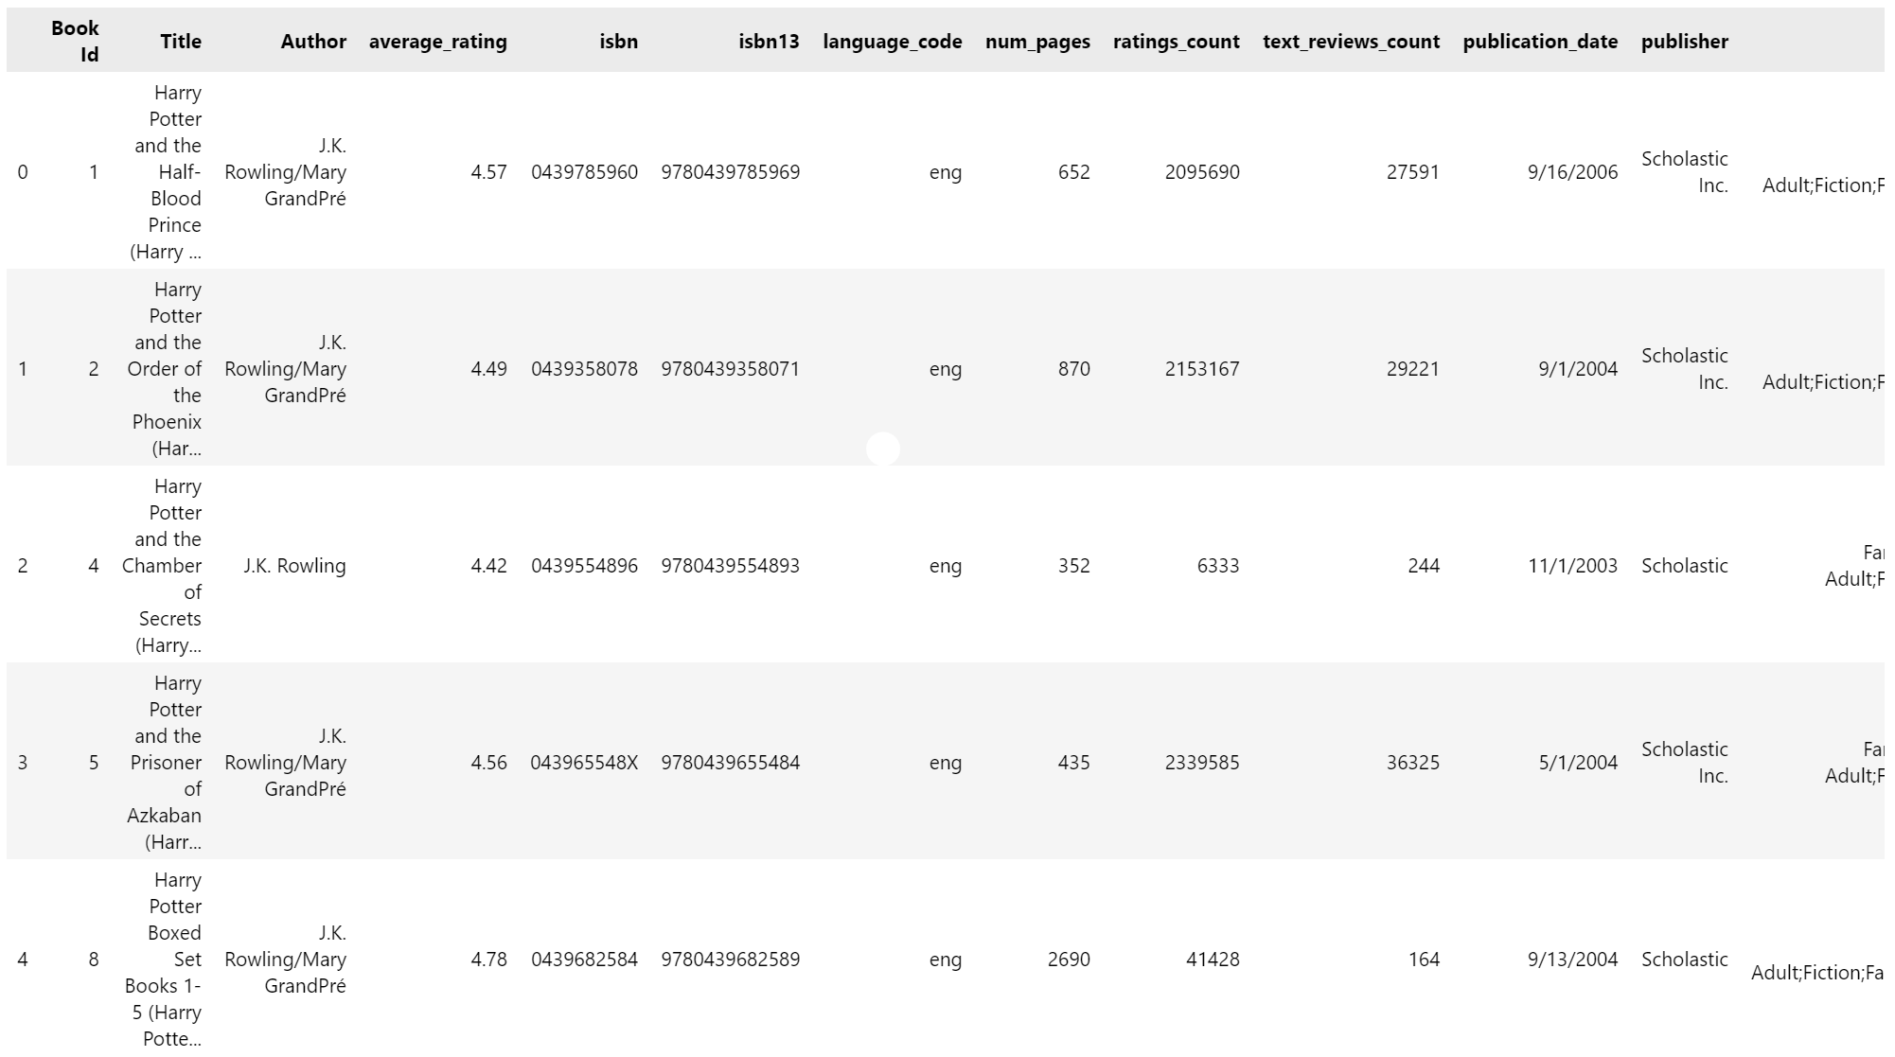
Why Book Recommendation App and the Process:
I like reading books.
I like to see similar books that I have read previously.
I like when an app gives me recommendations for my next book.
Used 2019 dataset created by Goodreads API.
It’s been updated in 2022 with genre information.
Found the datasel through Kaggle.
The dataset includes 11030 non-null rows and 13 columns/variables.
Columns include informations about: Book ID, title, author, average rating, isbn, isbn13, language of books, number of pages, ratings count, text reviews count, publication data, publisher, genres.
In this project;
Pandas
Matplotlib
Wordcloud

Slide 3
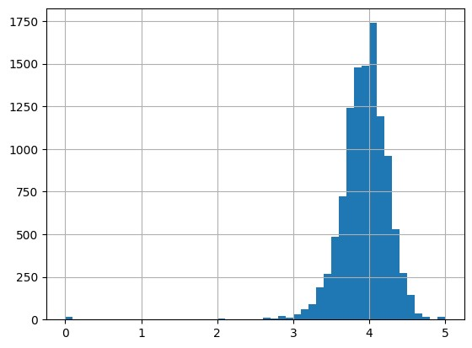
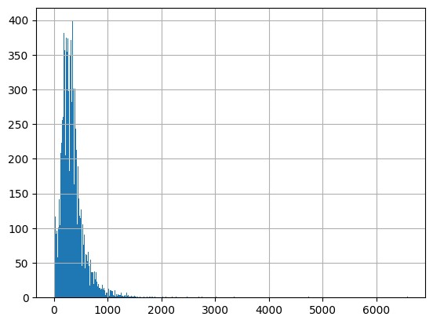
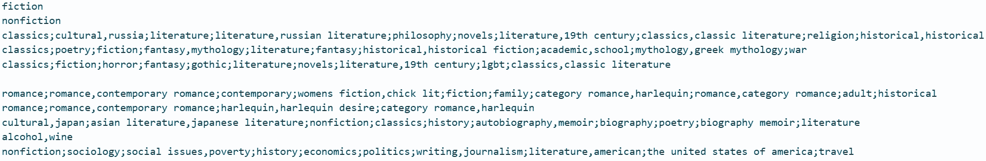
Difficulties During the Process:
average rating
numbe
r of page
s
Data is clean BUT:
Outliers
Genres column
Deciding to use which variable for measurement.
Learning Modules:
Pandas: Coray Schafer Python Pandas Youtube Playlist
Matplotlib: Coray Schafer Python Matplotlib Youtube Playlist
Wordcloud
genres

Slide 4
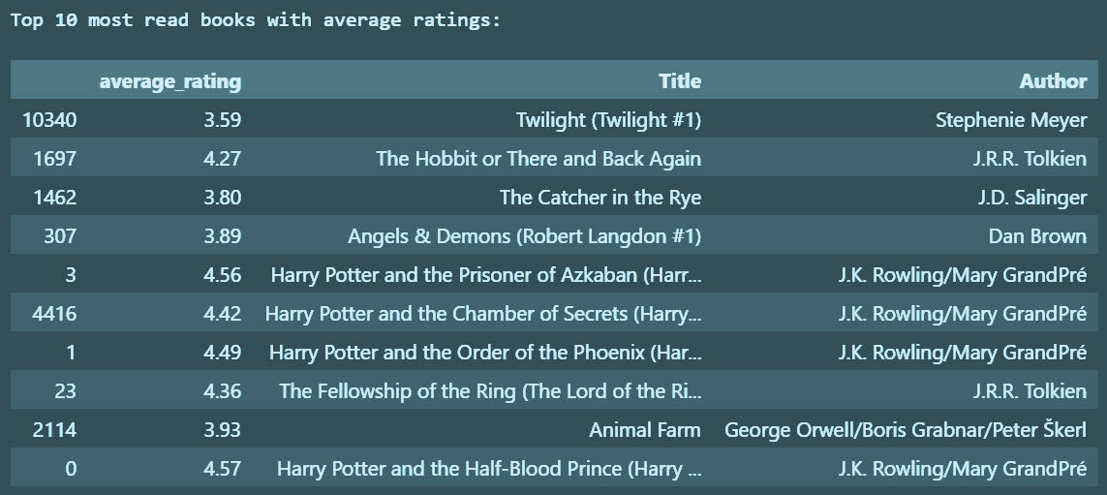
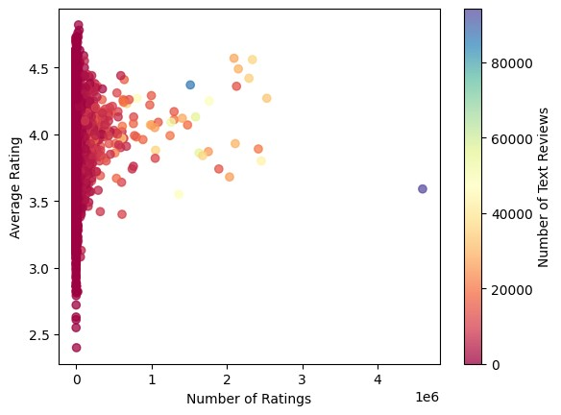
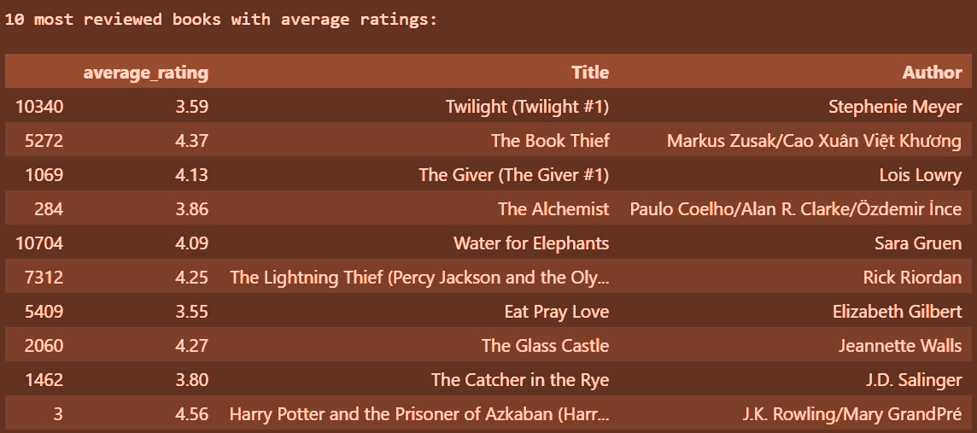
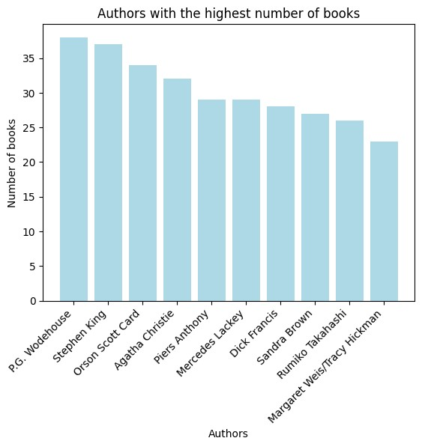
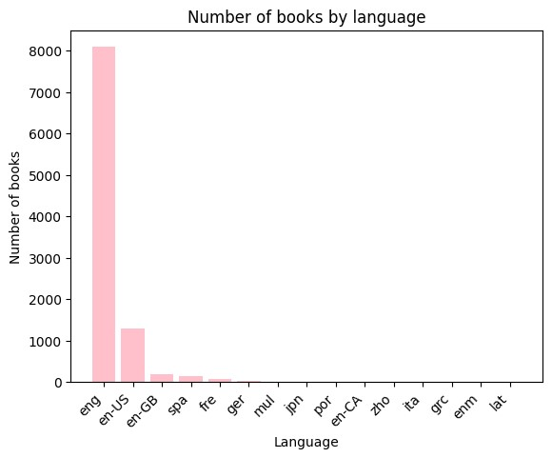
Exploring the Data:

Slide 5
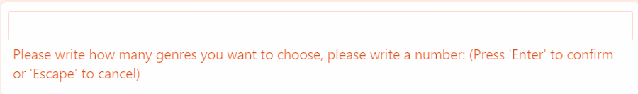
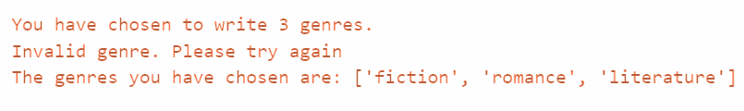
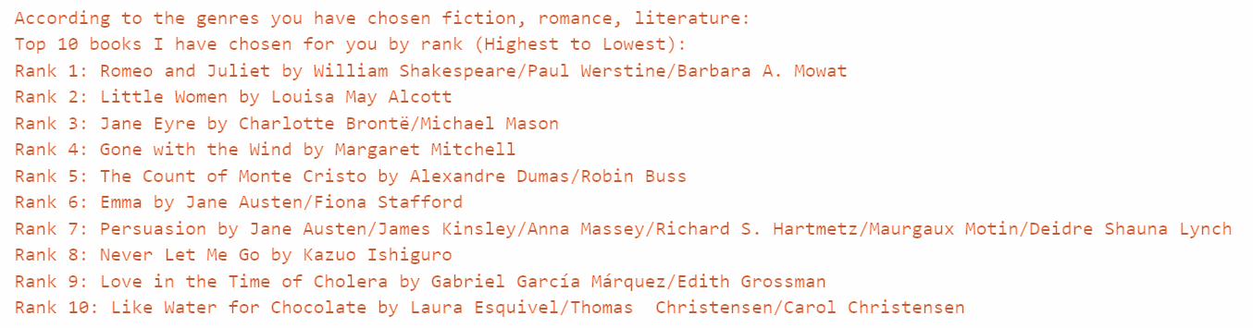
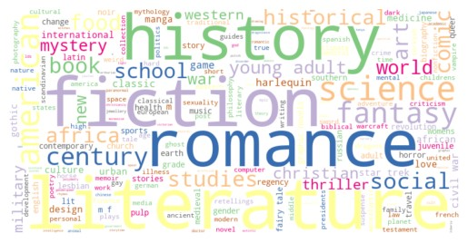
The Product & The Outcome:
The main aim of this project is to ask users/readers to recommend their next book based on genres they choose.
Users can decide how many genres they want to write. Program raises an error if genre is not found or with a typing error.
User had 3 trials for each genre selection.
848 unique genres.

Slide 6
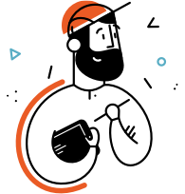

Future Steps:
It can be part of a website, such as goodreads, 1000kitap, or any online bookshop.
Recommendation system can be based on random book selection instead of genres.
Extensive, culturally varied, and current data is needed.
Recommendation can be extended for language.
Your inputs or questions?
Original code source: https://github.com/zeybus/Book_Recommendation_Project

Slide 7
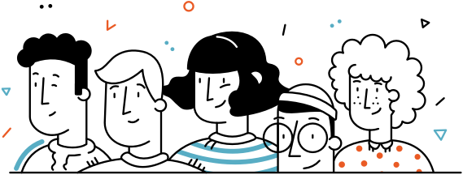
Thank You!

